Slide 1

QUIZ GAME
CSB 101 Project
Presented By :
RIHA SANJAY KOKODE
201210036
ANAVI SOMANI
201210005
Guide:
Dr. Chandra Prakash Sir
(Faculty, NIT Delhi)
March 2021

Slide 2
QUIZ GAME
Problem statement
Solution Proposed
Advantages
About Program
Environment setup/ used
Functions used / created
Result / Outcome
My Learning / Problem Faced
Future Work
Demo

Slide 3
Problem statement
Working on QUIZ GAME Project (in C).
The ‘MCQ Quiz Application’ project will be developed to overcome the time consuming problem of manual system.
Apart from that in current system, checking the answer sheets after taking test, waste the examiners time, so this application will check the correct answer and save the examiner time and carry the examination in an effective manner.

Slide 4
Solution Proposed
The process of quiz game is fully automated.
The proposed system is highly error and mistake proof as no information has been entered manually thus reducing the human prone errors.
Database of the player is stored in a record file.
Functionalities of the project will be as following: -
Able the users to have fun solving the quiz
Programmer can manage the information regarding quiz
Correct answers will be evaluated by system
Users can see their result at the end of game

Slide 5
About Program
The QUIZ GAME is based on LINUX Environment setup.
Made header file. (game.h)
Divided project into many functions and listed below are some of those which may help you understand the project better.
maxx_score() : shows the highest score
Start() : to begin your quiz game
help() : help menu with game summary and rules
In this quiz game project, you can
Store the username
View the highest score secured by a user
Use help mode

Slide 6

Used file handling for recording the score secured in a file.
Usage of multiple functions.
Not using file handling in C for reading and storing questions may seem a bad idea, but this project can guide you to create similar Quiz games by using file handling for aforesaid operations.

Slide 7
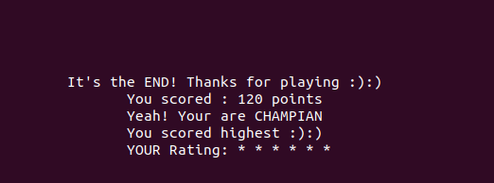
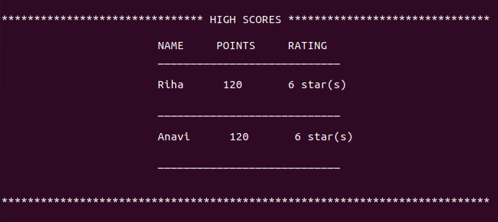
Result/ Outcome
Users is able to see their result at the end of game.
Text file score.txt is created.
Scores of players are recorded in score.txt successfully.

Slide 8
My Learning/ Problem Faced
My Learning :
In this project, almost every basic concept of “C Language”.
Creating a header file. The creation of header files are needed generally while writing large C programs so that the modules can share the function definitions, prototypes etc.
It was fun doing something new.
Problems Faced :
Clear screen issue
As <conio.h> isn't Linux friendly, tried to use <ncurses.h> but could not get the desired output.

Slide 9
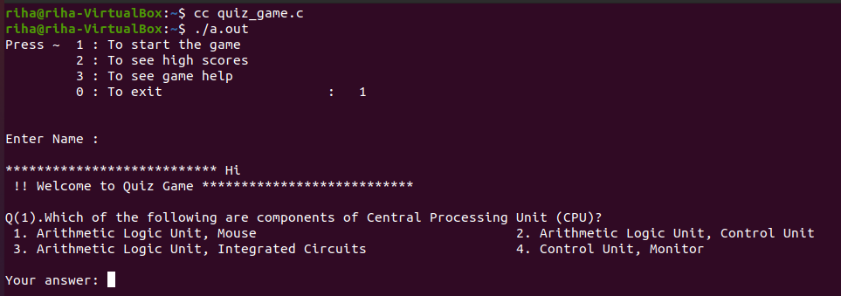
My Learning/ Problem Faced
String literal with spacing
Tried to take string input with space using different methodology but unable to get. Always an error was detected.

Slide 10
Future Work
Nothing is 100% perfect, there always a scope of improvement. Similarly this project can be improved further.
There are many areas in this project which can be expanded more on a larger scale that could not be achieved due limited time and resources.
Further research needs to be done to meet the requirements of a learner.
Following are some implications and changes that can be done in this project:
Improving the graphical user interface. Can probably use graphics to add some shapes and colors for more appealing.
Working on string literal.
Working on <ncurses.h> header file.
Making it more user friendly and interactive so that more and more players can play and enjoy the game with ease.

Slide 11
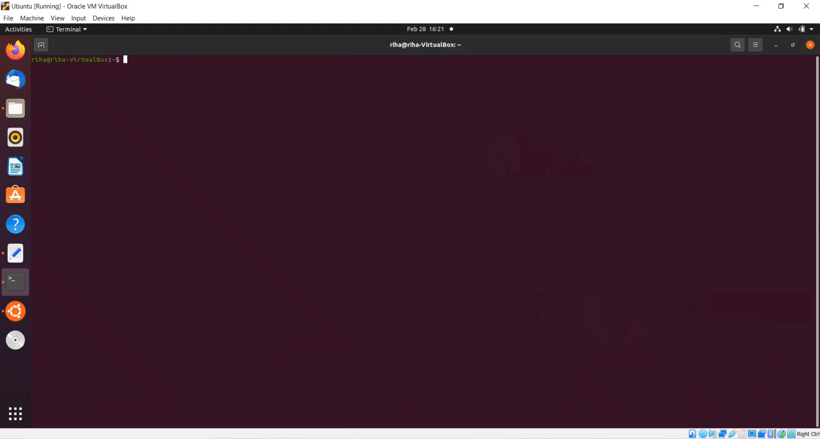
Demo

Slide 12
References
https://www.geeksforgeeks.org/
https://www.jagranjosh.com/general-knowledge-general-knowledge-quiz-1392962588-1
General knowledge book
Guided by Priya Maheshwari

